Slide 1
Data Classification

Slide 2
Classification Problems
Given input:
Predict the output (class label)
Binary classification:
Multi-class classification:
Learn a classification function:
Regression:

Slide 3
Examples of Classification Problem
Text categorization:
Doc: Months of campaigning and weeks of round-the-clock efforts in Iowa all came down to a final push Sunday, …
Politics
Sport
Topic:

Slide 4
Examples of Classification Problem
Text categorization:
Input features :
Word frequency
{(campaigning, 1), (democrats, 2), (basketball, 0), …}
Class label:
‘Politics’:
‘Sport’:
Doc: Months of campaigning and weeks of round-the-clock efforts in Iowa all came down to a final push Sunday, …
Politics
Sport
Topic:

Slide 5
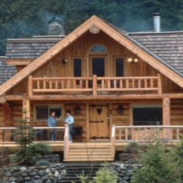
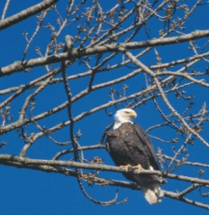
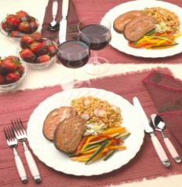
Examples of Classification Problem
Image Classification:
Input features X
Color histogram
{(red, 1004), (red, 23000), …}
Class label y
Y = +1: ‘bird image’
Y = -1: ‘non-bird image’
Which images have birds, which one does not?

Slide 6
Examples of Classification Problem
Image Classification:
Input features
Color histogram
{(red, 1004), (blue, 23000), …}
Class label
‘bird image’:
‘non-bird image’:
Which images are birds, which are not?

Slide 7
Supervised Learning
Training examples:
Identical independent distribution (i.i.d) assumption
A critical assumption for machine learning theory

Slide 8
Regression for Classification
It is easy to turn binary classification into a regression problem
Ignore the binary nature of class label y
How to convert multiclass classification into a regression problem?
Pros: computational efficiency
Cons: ignore the discrete nature of class label

Slide 9
K Nearest Neighbour (kNN) Classifier
(k=1)

Slide 10
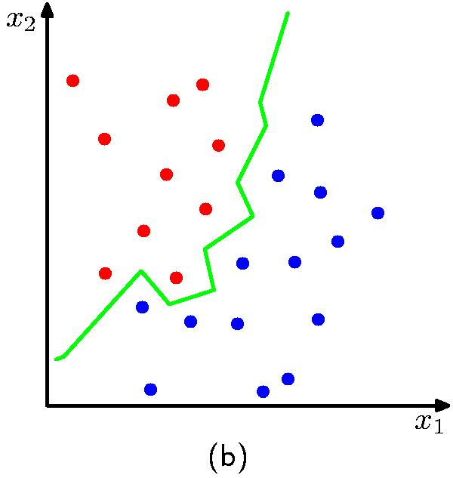
K Nearest Neighbour (kNN) Classifier
K = 1

Slide 11
K Nearest Neighbour (kNN) Classifier
How many neighbors should we count ?
(k=4)
(k=1)

Slide 12
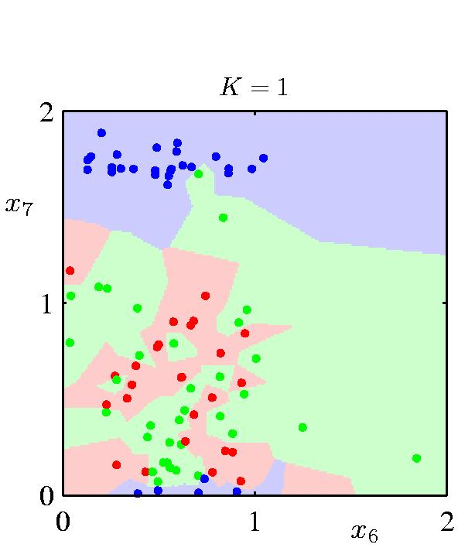
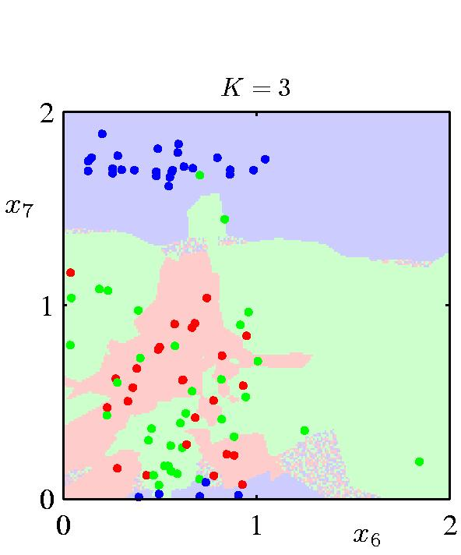
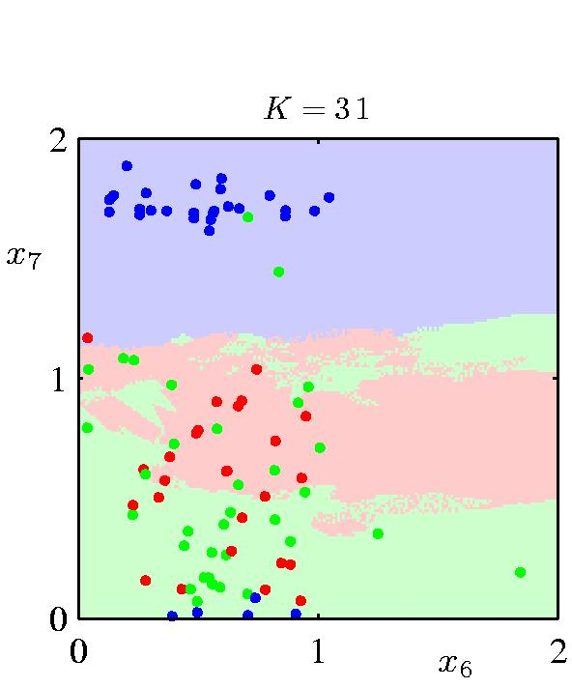
K Nearest Neighbour (kNN) Classifier
K acts as a smother

Slide 13
Cross Validation
Divide training examples into two sets
A training set (80%) and a validation set (20%)
Predict the class labels for validation set by using the examples in training set
Choose the number of neighbors k that maximizes the classification accuracy

Slide 14
Leave-One-Out Method

Slide 15
Leave-One-Out Method

Slide 16
Leave-One-Out Method
(k=1)

Slide 17
Leave-One-Out Method
(k=1)
err(1) = 1

Slide 18
Leave-One-Out Method
err(1) = 1

Slide 19
Leave-One-Out Method
err(1) = 3
err(2) = 2
err(3) = 6
k = 2

Slide 20
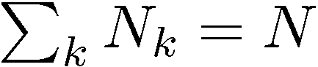
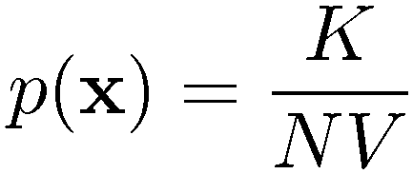
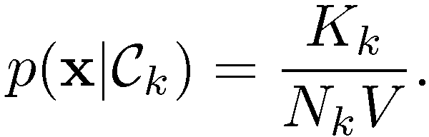
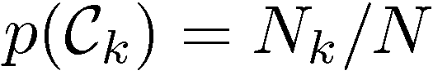
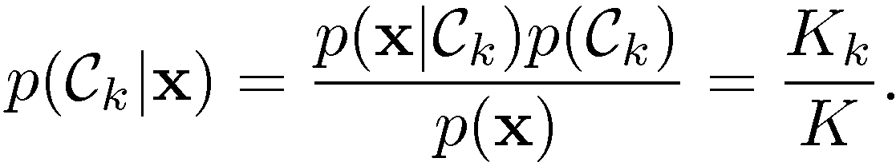
K-Nearest-Neighbours for Classification (1)
Given a data set with N_{k} data points from class C_{k} and , we have
and correspondingly
Since , Bayes’ theorem gives

Slide 21
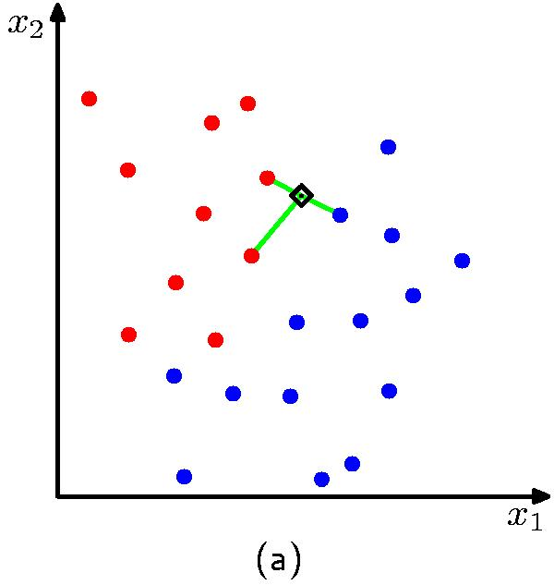
K-Nearest-Neighbours for Classification (2)
K = 3
K = 1

Slide 22
Probabilistic Interpretation of KNN
Estimate conditional probability Pr(y|x)
Count of data points in class y in the neighborhood of x
Bias and variance tradeoff
A small neighborhood → large variance → unreliable estimation
A large neighborhood → large bias → inaccurate estimation

Slide 23
Weighted kNN
Weight the contribution of each close neighbor based on their distances
Weight function
Prediction

Slide 24
Nonparametric Methods
Parametric distribution models are restricted to specific forms, which may not always be suitable; for example, consider modelling a multimodal distribution with a single, unimodal model.
Nonparametric approaches make few assumptions about the overall shape of the distribution being modelled.

Slide 25
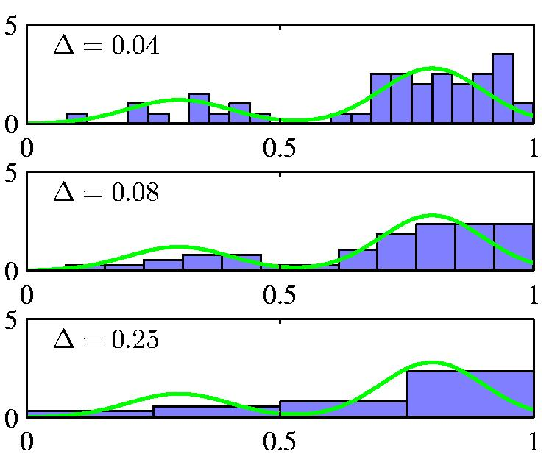
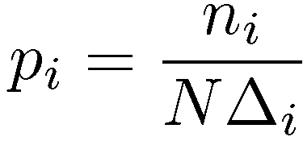
Nonparametric Methods (2)
Histogram methods partition the data space into distinct bins with widths ¢_{i} and count the number of observations, n_{i}, in each bin.
Often, the same width is used for all bins, ¢_{i} = ¢.
¢ acts as a smoothing parameter.
In a D-dimensional space, using M bins in each dimen-sion will require M^{D} bins!

Slide 26
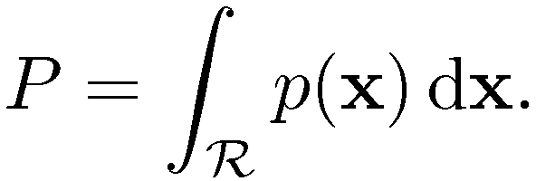
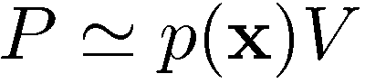
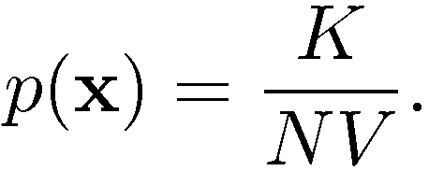
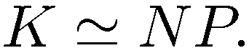
Nonparametric Methods
Assume observations drawn from a density p(x) and consider a small region R containing x such that
The probability that K out of N observations lie inside R is Bin(KjN,P ) and if N is large
If the volume of R, V, is sufficiently small, p(x) is approximately constant over R and
Thus
V small, yet K>0, therefore N large?

Slide 27
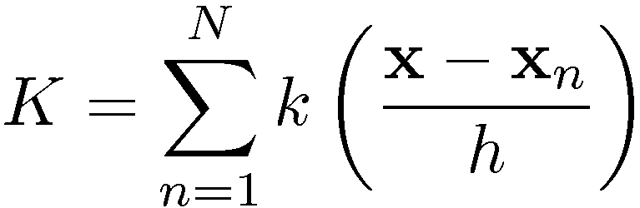
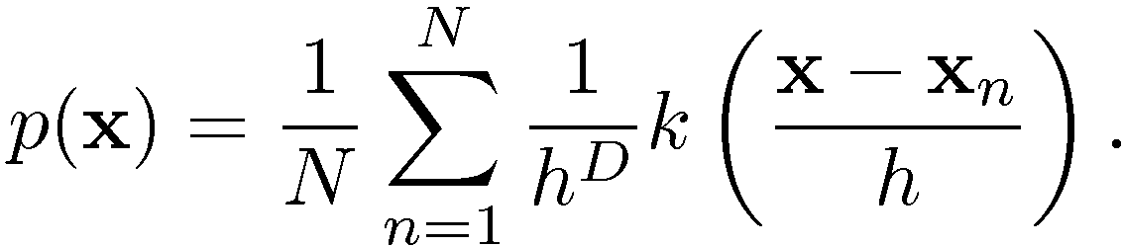
Nonparametric Methods
Kernel Density Estimation: fix V, estimate K from the data. Let R be a hypercube centred on x and define the kernel function (Parzen window)
It follows that
and hence

Slide 28
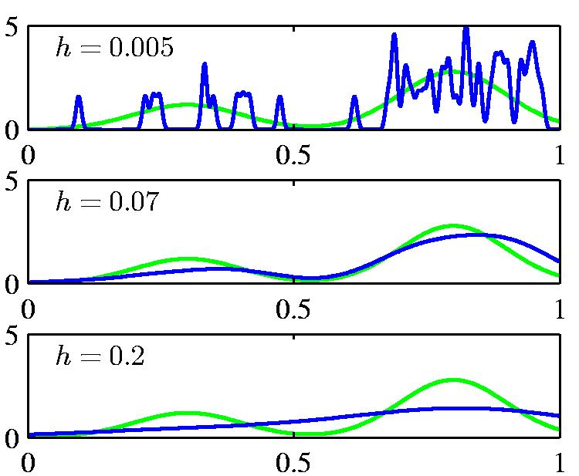
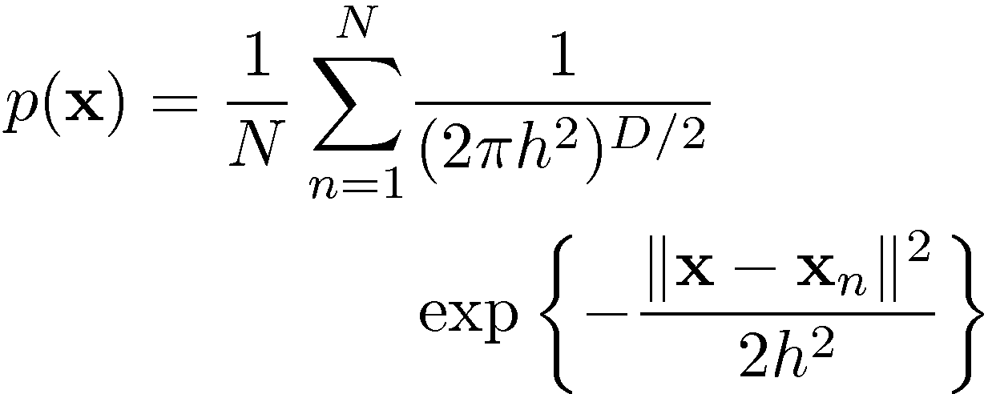
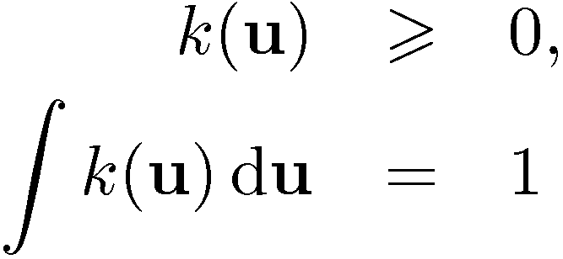
Nonparametric Methods
To avoid discontinuities in p(x), use a smooth kernel, e.g. a Gaussian
Any kernel such that
will work.
h acts as a smoother.

Slide 29
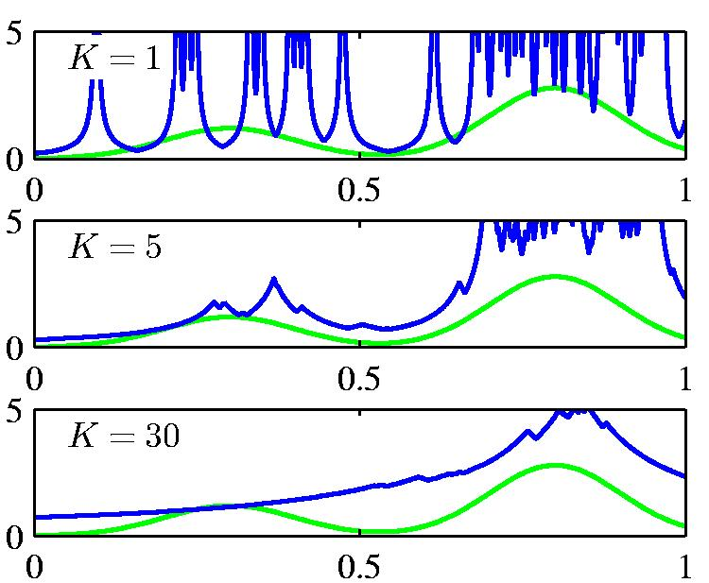
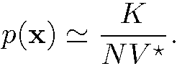
Nonparametric Methods (6)
Nearest Neighbour Density Estimation: fix K, estimate V from the data. Consider a hypersphere centred on x and let it grow to a volume, V ?, that includes K of the given N data points. Then
K acts as a smoother.

Slide 30
Nonparametric Methods
Nonparametric models (not histograms) requires storing and computing with the entire data set.
Parametric models, once fitted, are much more efficient in terms of storage and computation.

Slide 31
Estimate in the Weight Function

Slide 32
Estimate in the Weight Function
Leave one cross validation
Divide training data D into two sets
Validation set
Training set
Compute leave one out prediction

Slide 33
Estimate in the Weight Function

Slide 34
Estimate in the Weight Function
In general, for any training example, we have
Validation set
Training set
Compute leave one out prediction

Slide 35
Estimate in the Weight Function

Slide 36
Estimate in the Weight Function

Slide 37
Challenges in Optimization
Convex functions
Single-mode functions (quasi-convex)
Multi-mode functions (DC)
Difficulty in optimization

Slide 38
ML = Statistics + Optimization
Modeling
θ is the parameter(s) to be decided
Search for the best parameter θ
Maximum likelihood estimation
Construct a log-likelihood function
Search for the optimal solution θ

Slide 39
When to Consider Nearest Neighbor ?
Lots of training data
Less than 20 attributes per example
Advantages:
Training is very fast
Learn complex target functions
Don’t lose information
Disadvantages:
Slow at query time
Easily fooled by irrelevant attributes

Slide 40
KD Tree for NN Search
Each node contains
Children information
The tightest box that bounds all the data points within the node.

Slide 41
NN Search by KD Tree

Slide 42
NN Search by KD Tree

Slide 43
NN Search by KD Tree

Slide 44
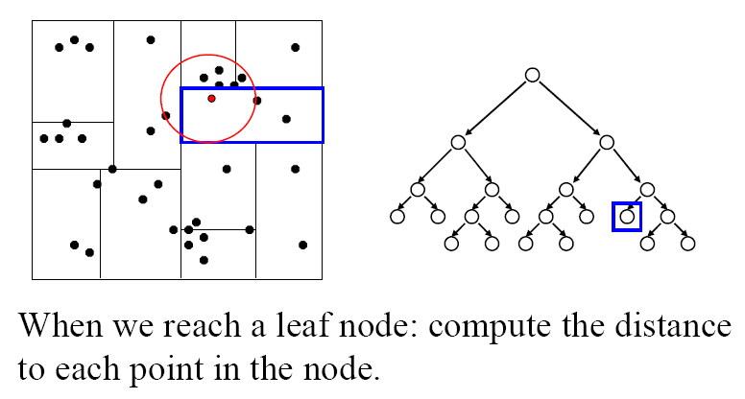
NN Search by KD Tree

Slide 45
NN Search by KD Tree

Slide 46
NN Search by KD Tree

Slide 47
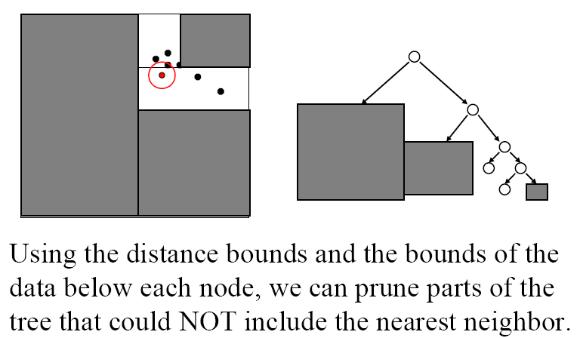
NN Search by KD Tree

Slide 48
Curse of Dimensionality
Imagine instances described by 20 attributes, but only 2 are relevant to target function
Curse of dimensionality: nearest neighbor is easily mislead when high dimensional X
Consider N data points uniformly distributed in a p-dimensional unit ball centered at origin. Consider the nn estimate at the original. The mean distance from the origin to the closest data point is:

Slide 49
Curse of Dimensionality
Imagine instances described by 20 attributes, but only 2 are relevant to target function
Curse of dimensionality: nearest neighbor is easily mislead when high dimensional X
Consider N data points uniformly distributed in a p-dimensional unit ball centered at origin. Consider the nn estimate at the original. The mean distance from the origin to the closest data point is:

